Slide 1






A new generation
of tech specialists

Slide 2
Prediction of Global
Temperature Change
BAQER HOSSINI

Slide 3

Outline
Concept note and implementation plan:​
Background​
Objectives​
SDG Relation​
Data​
Data Collection​
Exploratory Data Analysis (EDA) and Feature Engineering​
Model Selection and Training​
Model Evaluation and Hyperparameter Tuning​
Model Refinement and Testing​
Future Work
Conclusion

Slide 4
Concept Note and Implementation

Slide 5
Background
Brief project overview​
The project aims to leverage machine learning techniques to analyze and predict global temperature rise, a critical factor in understanding and mitigating the effects of climate change. The project's scope includes data analysis and preprocessing, regression model training, evaluation and prediction
Provide brief background​
Global temperature rise, often referred to as global warming, is a long-term increase in Earth's average surface temperature due to human activities, particularly the emission of greenhouse gases like carbon dioxide (CO2), methane (CH4), and nitrous oxide (N2O). This phenomenon is a key aspect of climate change and has far-reaching impacts on weather patterns, sea levels, ecosystems, and biodiversity

Slide 6
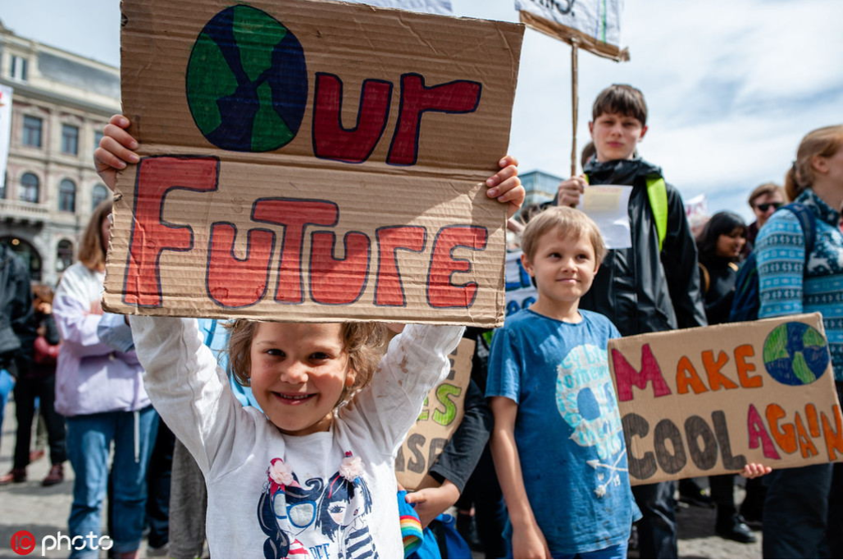
Background
Importance of the problem being solved
Continuously monitoring global temperature is crucial for all living beings, as our actions today directly impact future generations. By leveraging machine learning to predict changes in global temperature, we can gain valuable insights into whether we are on the right path. This approach helps ensure that we pass on a livable world to future generations by making informed decisions based on data-driven predictions.

Slide 7
Objectives
Develop a machine learning model to predict global temperature trends.
Enable timely responses to climate change impacts by forecasting future temperature changes.
Optimize resource allocation and policy decisions through accurate predictions, aiding in climate adaptation efforts.
Contribute to mitigating climate change effects by supporting informed decision-making and sustainable development initiatives.

Slide 8

SDG Relation
My project is aligned with Sustainable Development Goals (SDGs), specifically focusing on SDG 13: Climate Action. The main aim for this project is to predict the Global Temperature change in the future.

Slide 9
Data

Slide 10
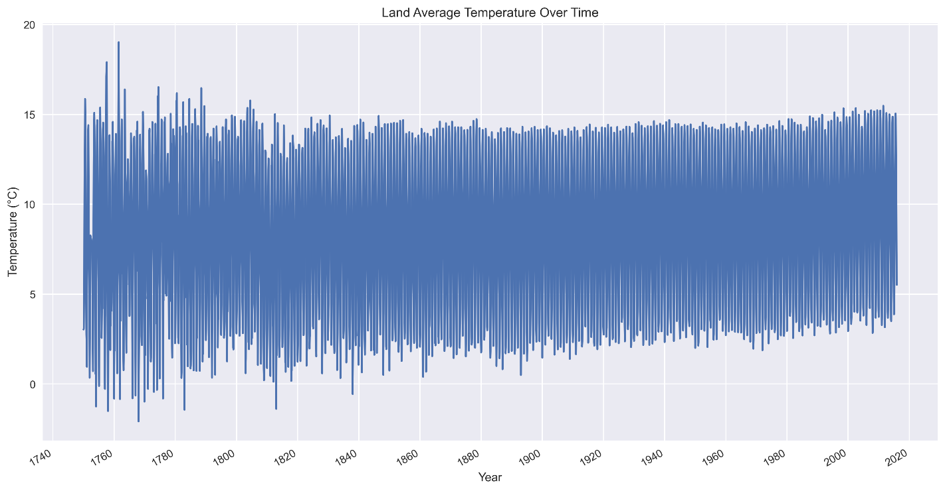
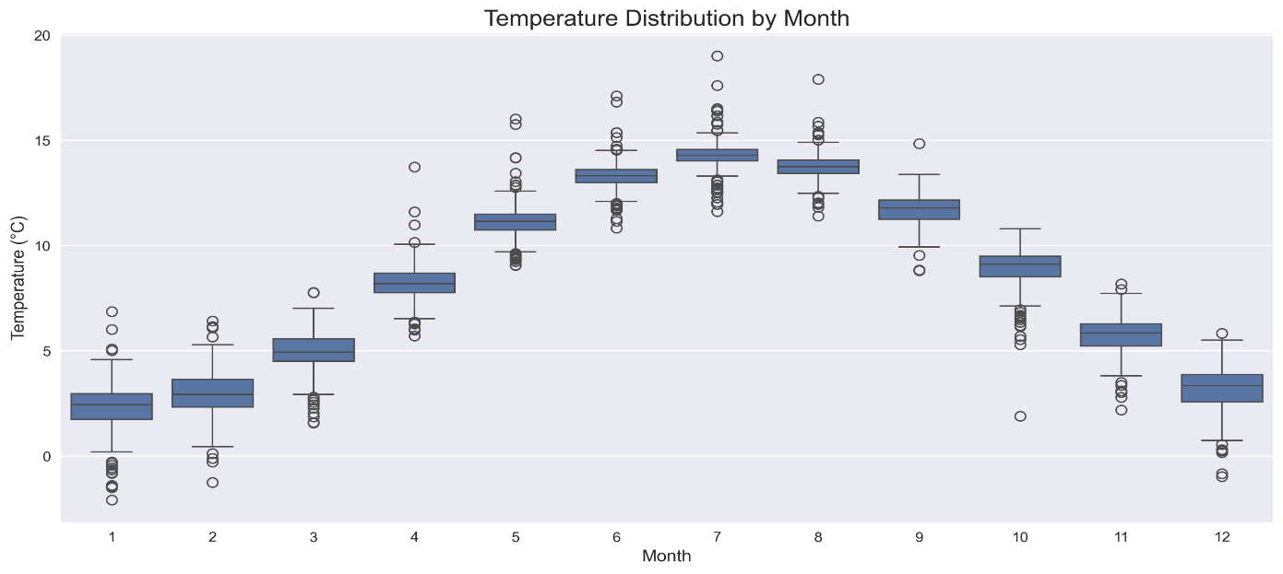
Data Collection
Source of the dataset​
Berkeley Earth
Kaggle
Preprocessing steps during data collection
Preprocessing steps involved collecting the needed data and filtering collected data for a period of 265(1750-2015) years. This ensured that the project mainly focus on the global temperature change in last centuries where the data is more accurate.​
Handling missing values, outliers
Data cleaning involved handling missing values by filling them with appropriate measures such as the mean, median, or zeros, depending on the dataset's characteristics.

Slide 11
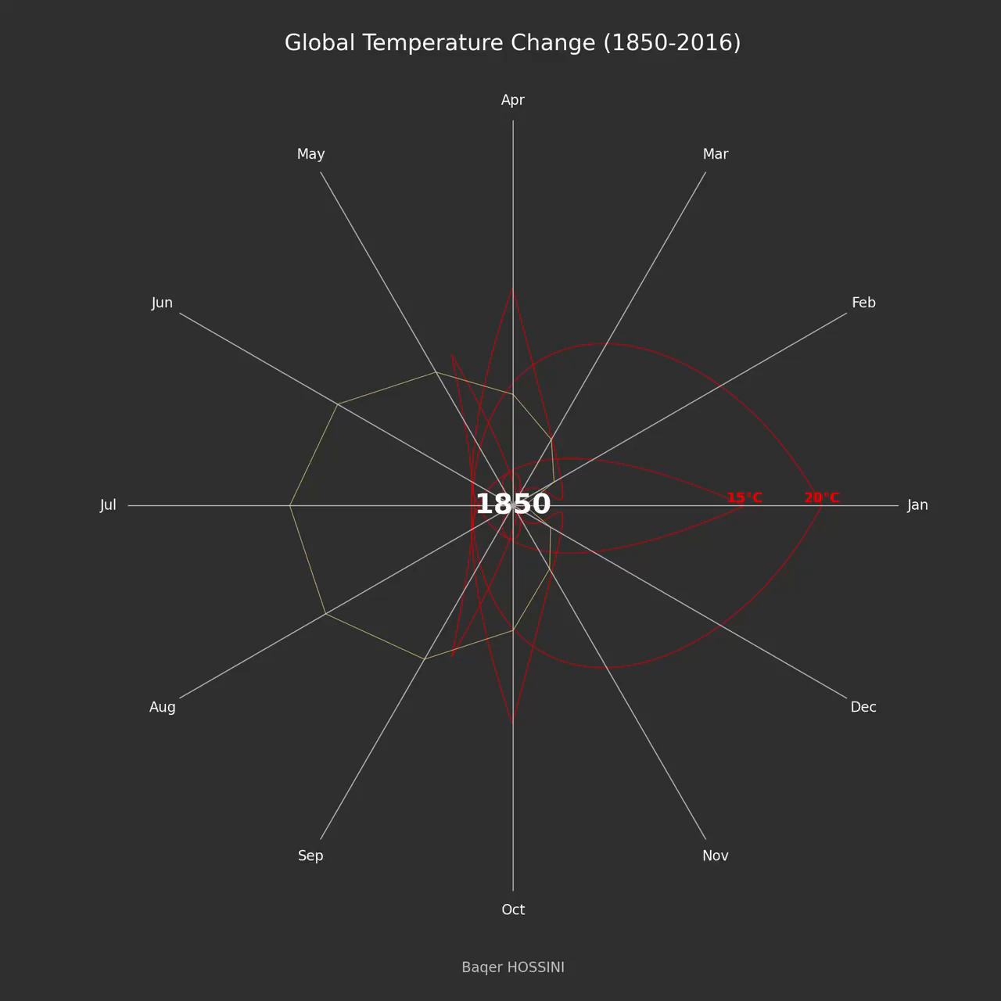
Data Collection
Global temperature Change

Slide 12
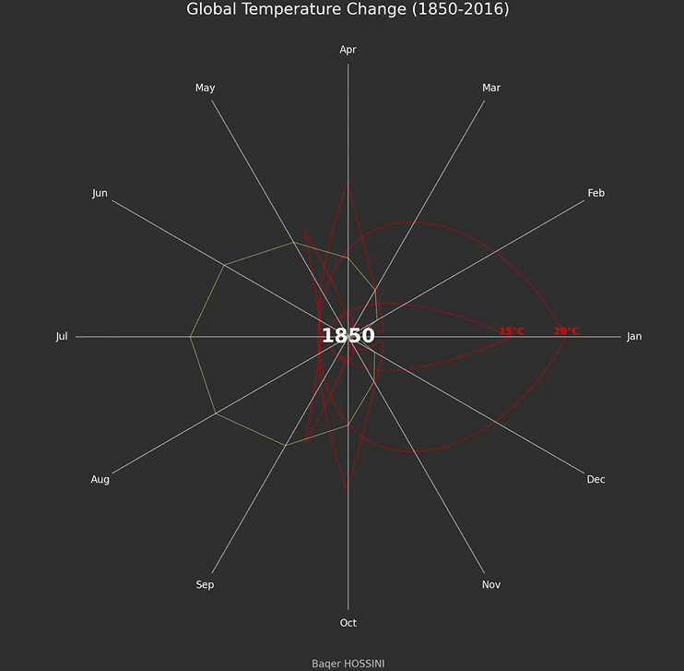
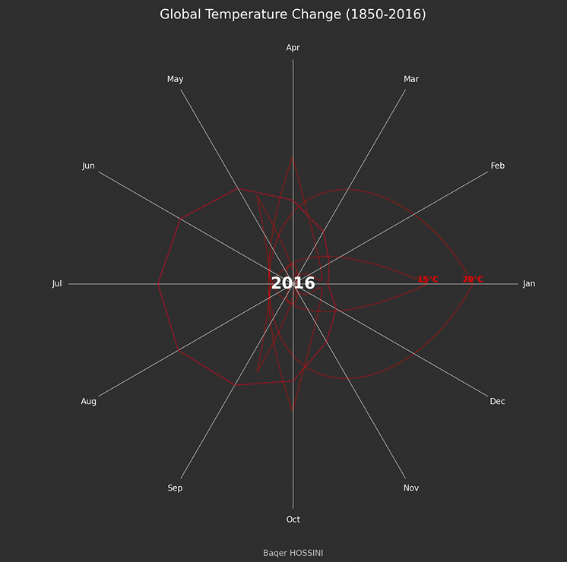
Data Collection

Slide 13
Exploratory Data Analysis (EDA) and Feature Engineering
The process of creating or transforming features​
Feature Selection and Removal: I extract key features such as year, month, season and Global Land Temperature. The year helps analyze long term trends, while month and season capture seasonal variations.

Slide 14
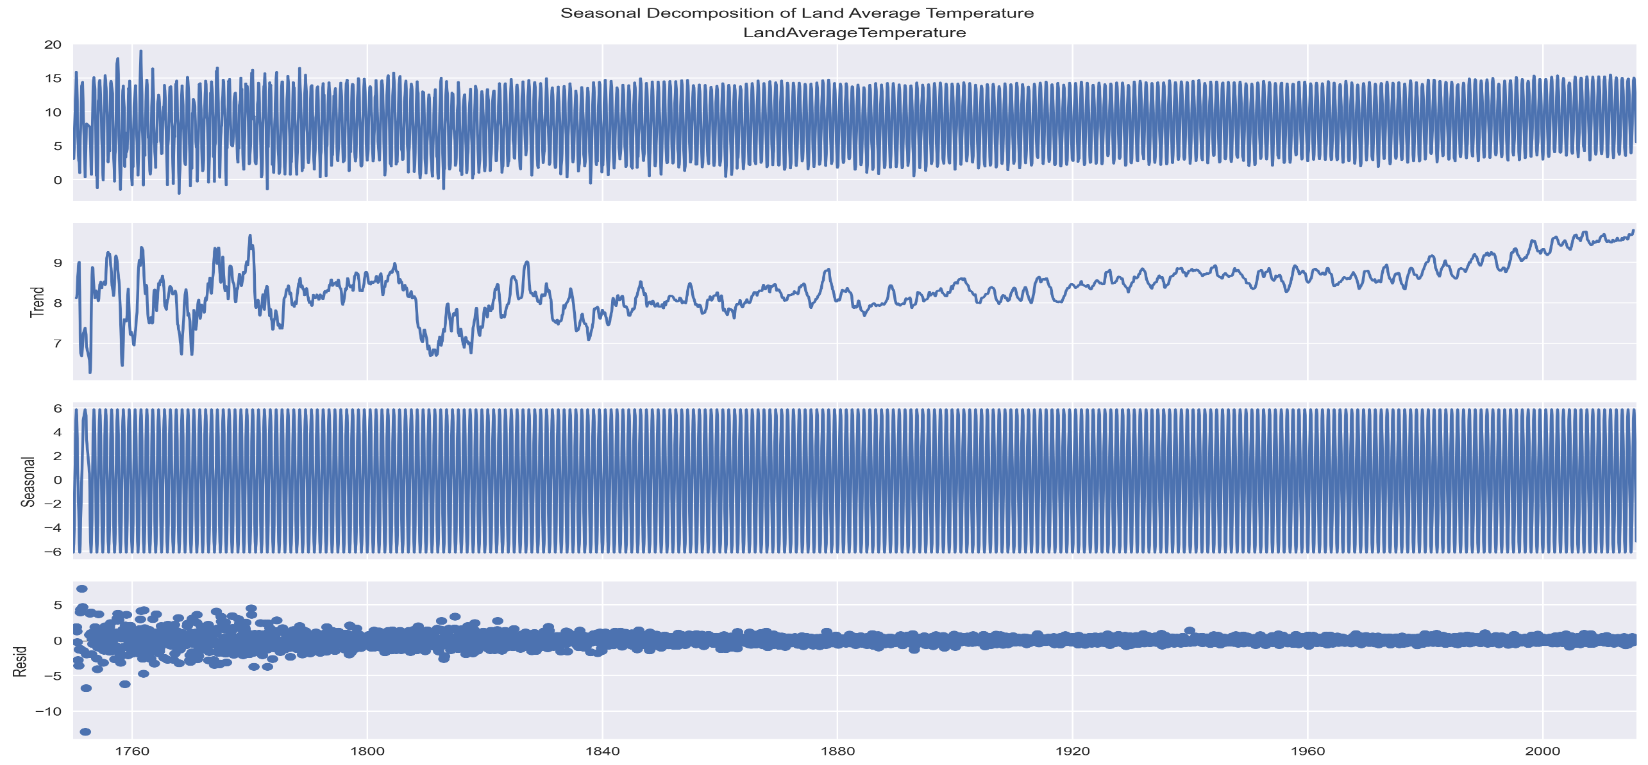
Exploratory Data Analysis (EDA) and Feature Engineering

Slide 15
Model

Slide 16
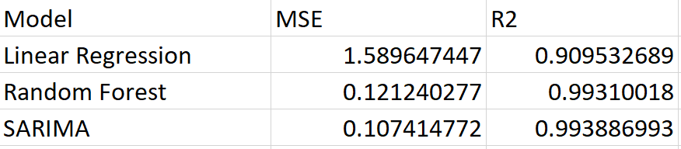
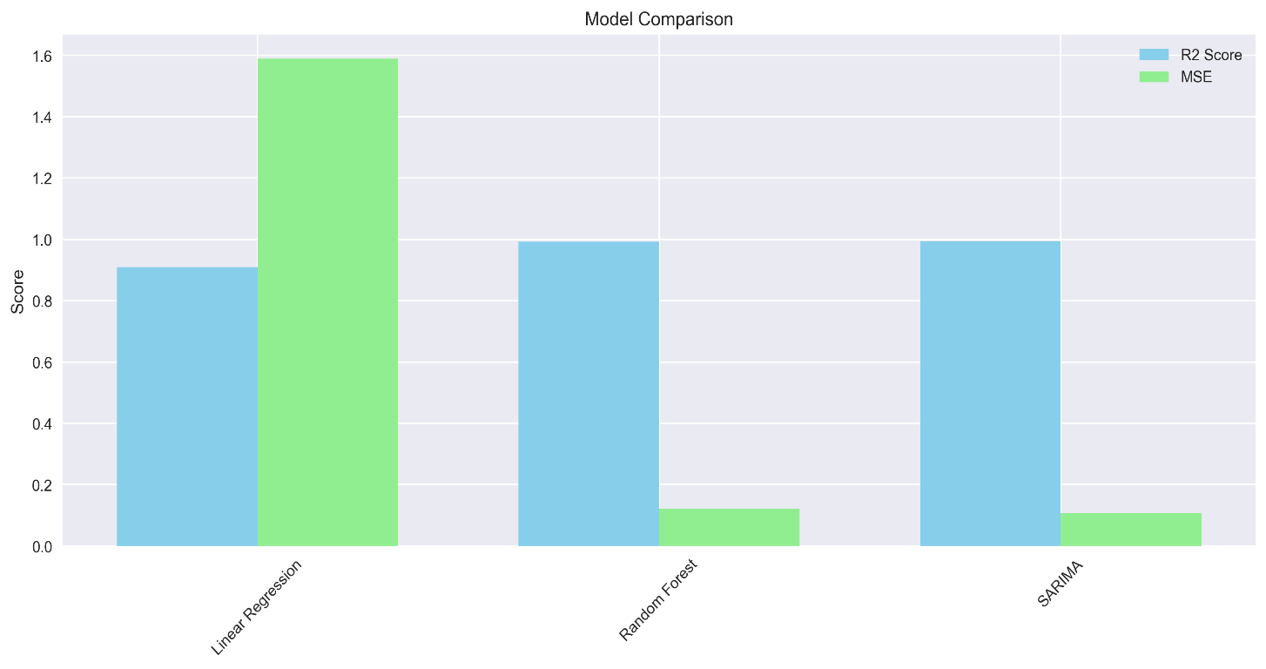
Model Selection and Training
Rationale for choosing specific model
Random Forest was selected for its superior performance metrics compared to other models evaluated
Strengths and Weaknesses​
Strengths: Handles non-linearity, reduces overfitting, provides feature importance.
Weaknesses: Can be slower to train, less interpretable.

Slide 17
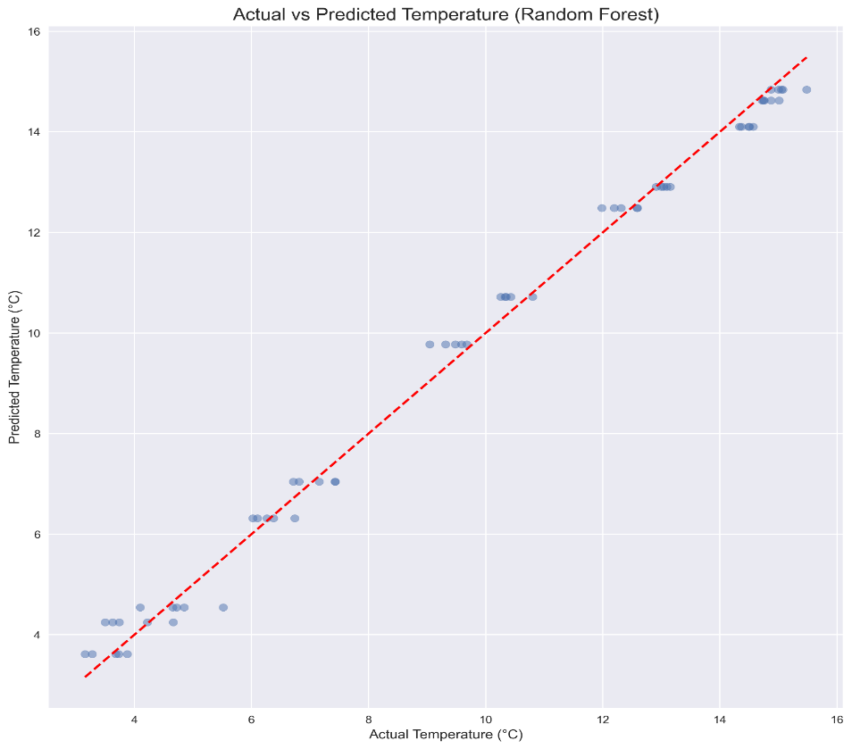
Model Selection and Training

Slide 18
Model Evaluation and Hyperparameter Tuning
Model Evaluation and Hyperparameter Tuning:
n_estimators: [100, 200]
max_depth: [None, 10, 20]
min_samples_split: [2, 5, 10]
min_samples_leaf: [1, 2, 4]
max_features: ['auto', 'sqrt', 'log2']
bootstrap: [True, False]
oob_score: [True, False]
random_state: [42]
criterion': ['squared_error', 'absolute_error', 'poisson']
max_leaf_nodes': [None, 10, 20]
min_impurity_decrease': [0.0, 0.1]
ccp_alpha': [0.0, 0.1]
Cross Validation: The GridSearchCV function is used to perform the hyperparameter tuning for Random Forest (5 Fold cross validation)

Slide 19
Model Evaluation and Hyperparameter Tuning
Model Refinement and Testing:
GridSearchCV is used to tune the hyperparameters of the Random Forest model, my code is refining the model to improve its performance, as result the MSE and R2 values are: 0.121240277 and 0.99310018, respectively.

Slide 20
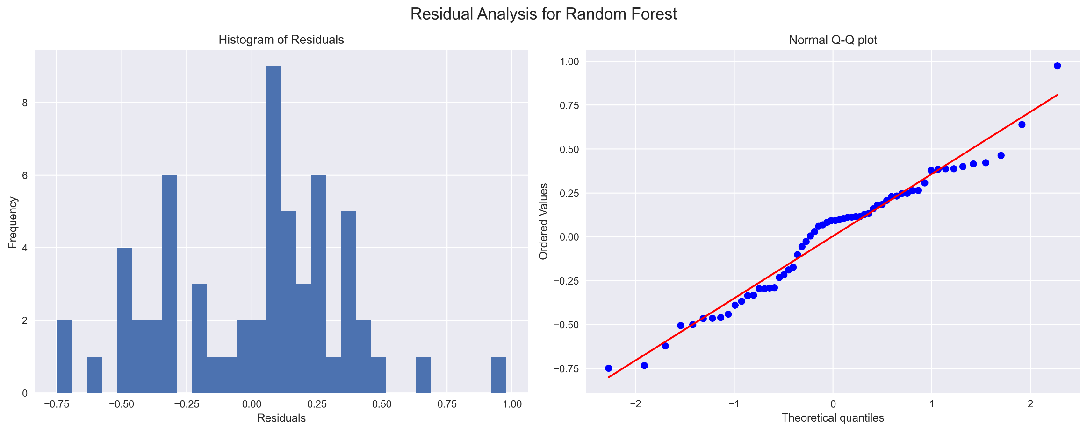
Model Evaluation and Hyperparameter Tuning

Slide 21
Result

Slide 22
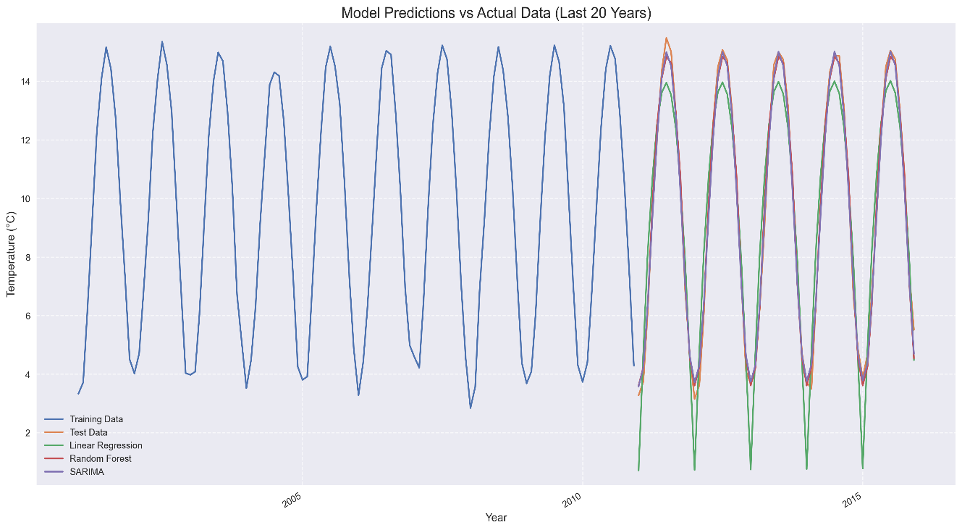
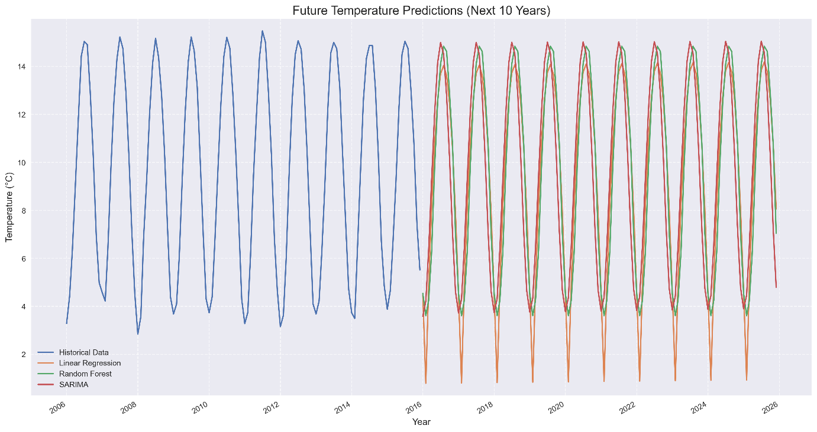
Evaluation Results

Slide 23
Futurework
Feature Expansion: Incorporate additional features like greenhouse gas concentrations, geographical variables, and socio-economic factors to enhance model robustness.
Real-time Data Integration: Implement real-time data collection and model updating to maintain prediction relevance and accuracy. Climate Change Scenarios: Analyze different climate change scenarios and their impact on future temperature predictions.
Cross-disciplinary Collaboration: Collaborate with climate scientists and policymakers to refine models and apply findings to real-world climate action strategies.

Slide 24
Conclusion
This project successfully predicted land average temperatures using historical data and machine learning models. Key steps included data preprocessing, exploratory data analysis, and model training with Linear Regression and Random Forest models. The Random Forest model, optimized through hyperparameter tuning, outperformed the Linear Regression model with an R2 score of 0.993 and an MSE of 0.121240.
Future temperature predictions for the next 10 years were generated, highlighting potential trends and variations. The Random Forest model's ability to capture complex, non-linear patterns made it the best choice for this task

Slide 25


Thank you!

